Slide 1
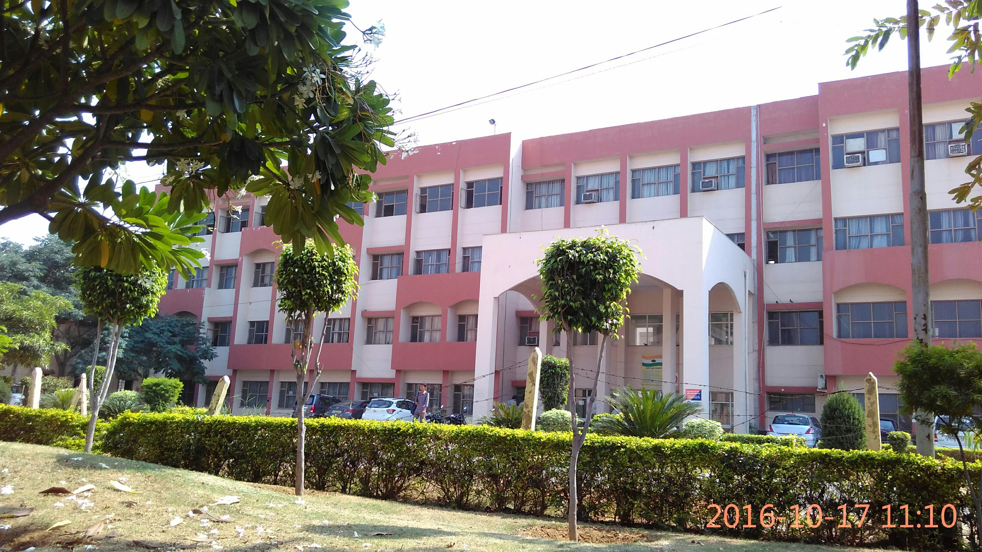
Govt. Polytechnic manesar(Gurugram)

Slide 2
Syllabus
Customer relations management (CRM)
Total Quality Management (TQM)
Intellectual Property Right (IPR)

Slide 3
Customer relations management (CRM)

Slide 10
Type of CRM

Slide 13
Total Quality Management (TQM)

Slide 14
What is the TQM
TQM is defined as an intensive, long term effort to transform all the parts of the organisation in order to produce the best products and services possible to meet customer needs
Statisfical process control
Total employees involvement
Just in time(जीत)

Slide 15
Advantage of the TQM
Employees feel that they having ownership of problems and authorities to find solution of their own
Improved organisational decisions making capacity
Reduction costs through eliminate of waste and reduce product cycle time
Enrichment of job
Generate feeling of personal worth and esteen among employees

Slide 16
Benefits of TQM

Slide 17
Characteristics of TQM LEADER

Slide 18
Intellectual property rights (IPR)

Slide 19
What is the IPR
The exclusive rights that a person enjoys with respect to his intellectual property are his intellectual property rights
Enlist type of IPRPatents
Patents
Trade marks
Designs
Copyright

Slide 20
Patents
A patent is a grant made by the government to an inverter that excluded other form manufacturing, using or selling the invention

Slide 21
Trademark
Trademark is any work, slogen, pictures and symbol used to identify a specific product from others of the same nature offered in the market

Slide 22
Copyright
Copyright isa form of protection provided to the author of original works of authority including dramatic, musical, books published and unpublished

